Slide 1
Medical Card Generation System Developed in PHP & MySQL

Slide 2
Abstract
The aim of this proposed of ‘Medical Card Generations System’ is to improve efficiency, access and accountability of health-care services and also develop to automate its existing manual system by the help of computerized equipment and full-fledge computer software, fulfilling their requirements so that their valuable date can be stored for a longer period with easy accessing and manipulation of the same. Basically the project describes how to handle good performance and provide better services to users. This project can lead to error free, secure, reliable and fast management system. This system will help the organization in better utilization of resources.

Slide 3
Introduction
The ‘Medical Card Generations System’ has been designed to override the problem of existing manual system. This web application is supported to eliminate and in some case reduce the hardship faced by manual system. The application is reduced as much as possible to avoid errors while entering the data. It’s also provide message while entering invalid data. No formal knowledge is required for the user to operate this system. Overall we said that ‘Medical Card Generations System’ is user friendly.
In ‘Medical Card Generations System’ we use PHP and MySQL Database. This project keeps the records of medical cards. ‘Medical Card Generations System’ has two module i.e. admin and user.

Slide 4
Project Objective
Now–a-days, health awareness is not only a growing trend among the nations but also among the individuals. After analyzing and surveying the current health care problems in cities as well as rural areas, we have proposed a “Medical Card Generations System” in order to improve the health care facilities. Then we have focused on analyzing the performance of the proposed health care system to eliminate problems in the existing health care system.
The main objective of the ‘Medical Card Generations System’ project is to manage the details of user medical cards and their enquiries. This ‘Medical Card Generations System’ will definitely reduce the time, energy and money wasted in manually searching the details of the medical cards. With the help of this software, all the services and users can be properly channelized. It is cost effective project and can be used in many organizations.

Slide 5
Purpose
Now–a-days, health awareness is not only a growing trend among the nations but also among the individuals. After analyzing and surveying the current health care problems in cities as well as rural areas, we have proposed a “Medical Card Generations System” in order to improve the health care facilities. Then we have focused on analyzing the performance of the proposed health care system to eliminate problems in the existing health care system.
The proposed “Medical Card Generations System” is to have everything completely automated and computerized. The software is very easy to use and manage even for a non technical person. The redundancy and ambiguity will be removed by assigning reference number to each medical card.

Slide 6
Project Modules
In ‘Medical Card Generations System’ we use PHP and MySQL Database. This project keeps the records of medical cards. ‘Medical Card Generations System’ has two module i.e. admin and user.
Admin
User

Slide 7
Admin Module
Dashboard: In this section, admin can briefly view the total medical card created in today’s, yesterday’s and in seven days, total read and unread enquiries.
Medical Card: In this section, admin can manage medical cards (add/delete/update).
Page: In this section, admin can manage about us and contact us pages.
Enquiry: In this section, admin reads the inquiries which are sent by users.
Search: In this section, admin can search a particular medical cards by reference number.
Reports of Medical Cards: In this section admin can view and check medical card details in a particular period.
Admin can also update his profile, change the password and recover the password.

Slide 8
User Module
Home Page: User can visit home page.
Medical Card: User can view his/her medical card and take print with the help of their Reference Number.
About Us: User sees the details of .website administrator.
Contact Us: User can contact with website administrator and sent enquiry to them.
Note: In this project, the MD5 encryption method was used.

Slide 9
Requirement Specification
Hardware Configuration:
Client Side
Server Side
RAM | 512 MB
Hard Disk | 10GB
Processor | 1.0 GHz
RAM | 1 GB
Hard Disk | 20GB
Processor | 2.0GHz

Slide 10
Continue.....
Software Requirement:
Client Side
Server Side
Web Browser | Google Chrome or any compatible browser
Operating System | Windows or any equivalent OS
Web Server | APACHE
Server side Language | PHP5.6 or above version
Database Server | MySQL
Web Browser | Google Chrome or any compatible browser
Operating System | Windows or any equivalent OS

Slide 11
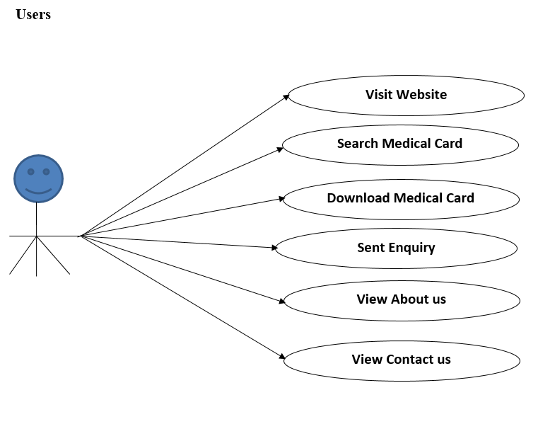
Use Case Diagram
Notes:
USECASE DIAGRAM: A Use case is a description of set of sequence of actions. Graphically it is rendered as an ellipse with solid line including only its name. Use case diagram is a behavioral diagram that shows a set of use cases and actors and their relationship. It is an association between the use cases and actors. An actor represents a real-world object. Primary Actor – Sender, Secondary Actor Receiver.

Slide 12
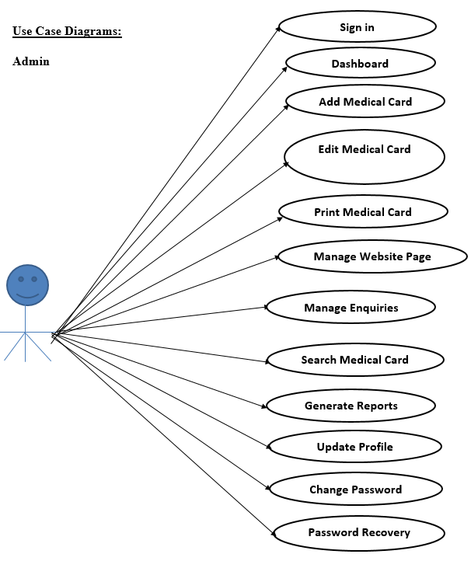
Continue.......

Slide 13
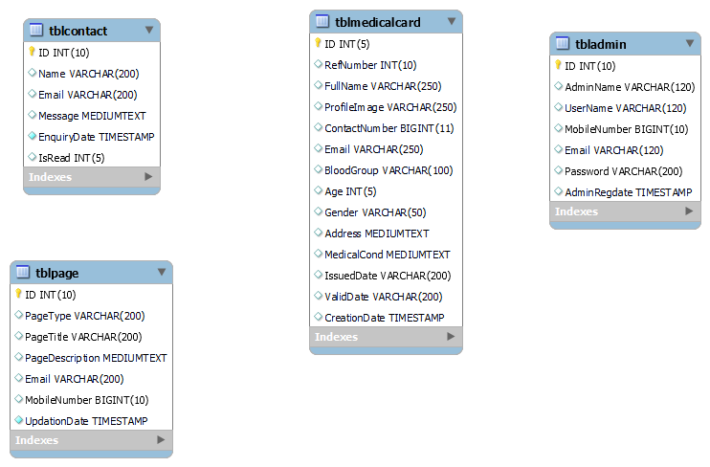
Class / Schema Diagram
Notes:
Class Diagram:
A description of set of objects that share the same attributes operations, relationships, and semantics

Slide 14
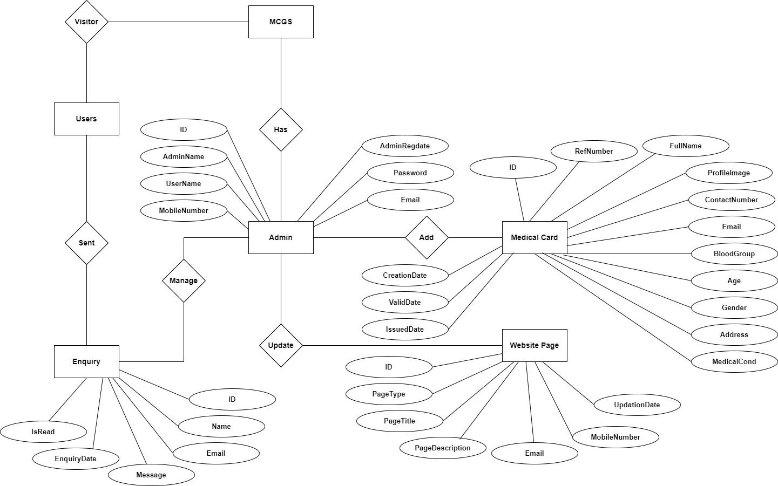
ER Diagram

Slide 15
Data Flow Diagram
A data flow diagram is graphical tool used to describe and analyze movement of data through a system. These are the central tool and the basis from which the other components are developed. The transformation of data from input to output, through processed, may be described logically and independently of physical components associated with the system.
These are known as the logical data flow diagrams. The physical data flow diagrams show the actual implements and movement of data between people, departments and workstations.

Slide 16
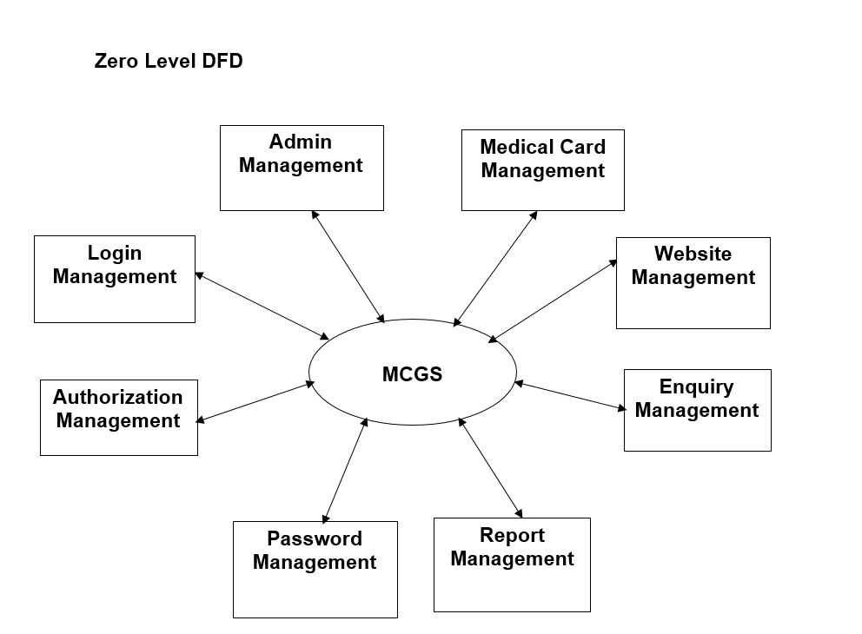
Continue…..

Slide 17
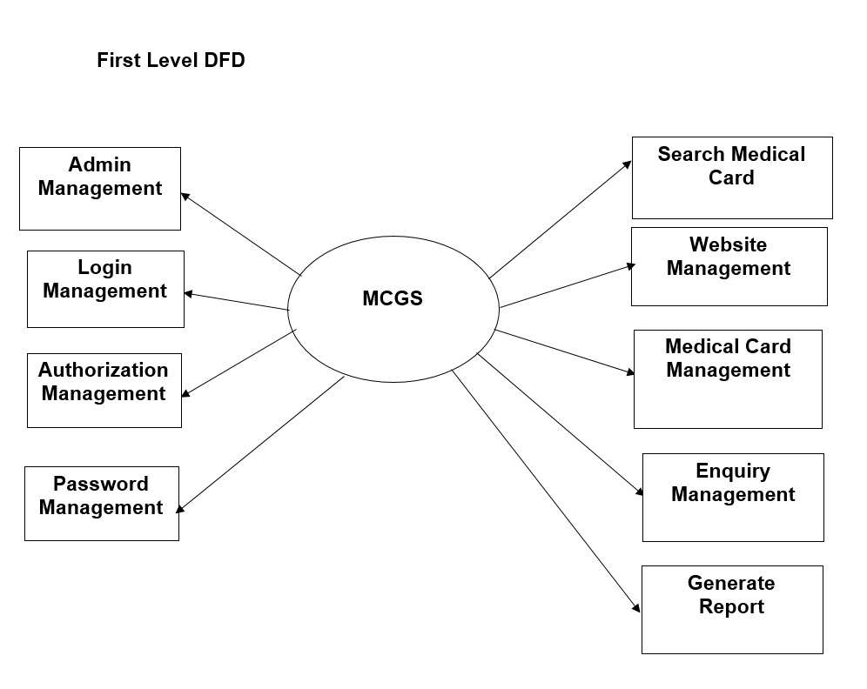
Continue…..

Slide 18
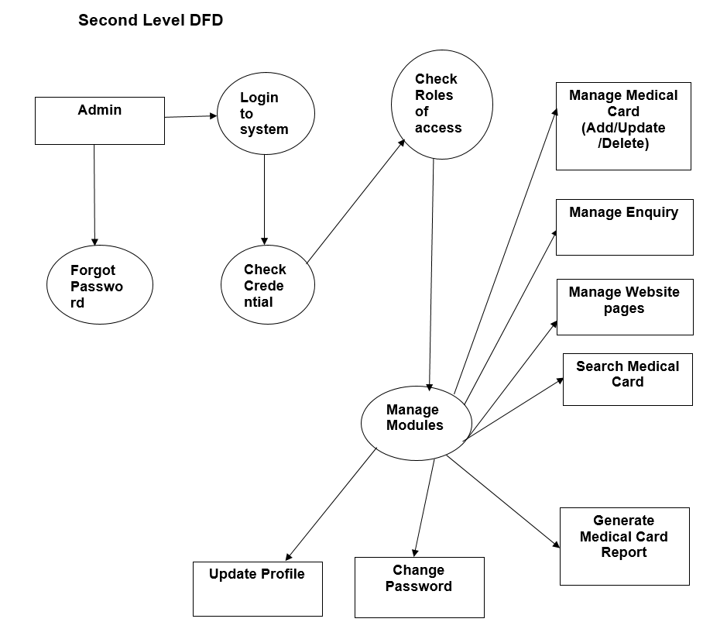
Continue…..

Slide 19
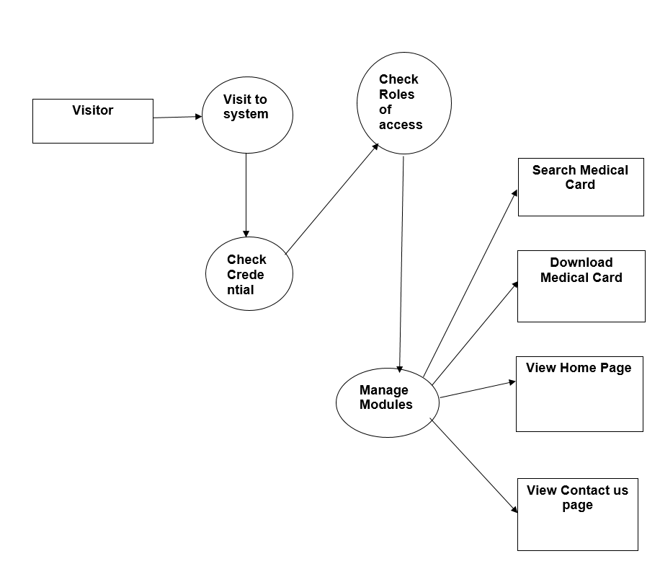
Continue…..

Slide 20
Implementation and System Testing
After all phase have been perfectly done, the system will be implemented to the server and the system can be used.
System Testing
The goal of the system testing process was to determine all faults in our project .The program was subjected to a set of test inputs and many explanations were made and based on these explanations it will be decided whether the program behaves as expected or not. Our Project went through two levels of testing
Unit testing
Integration testing

Slide 21

Project Screens

Slide 22
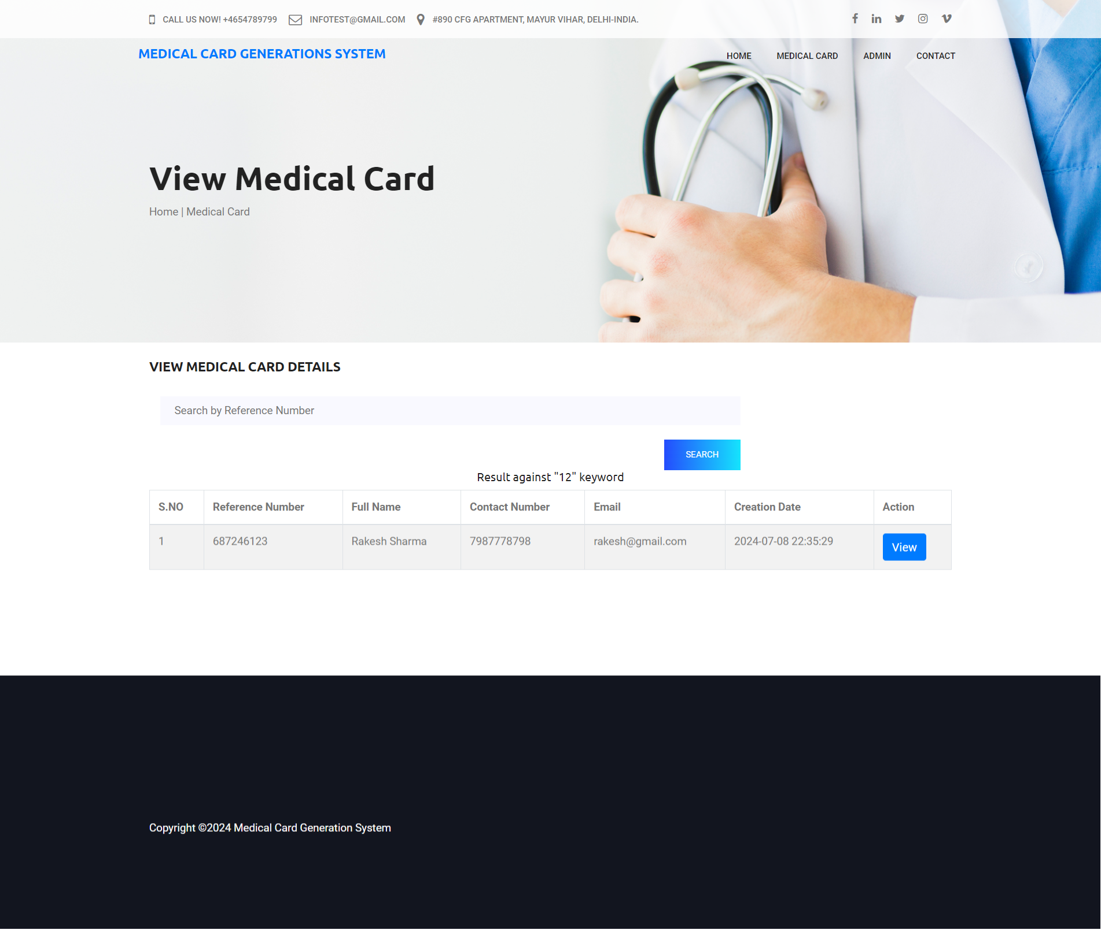

Slide 23
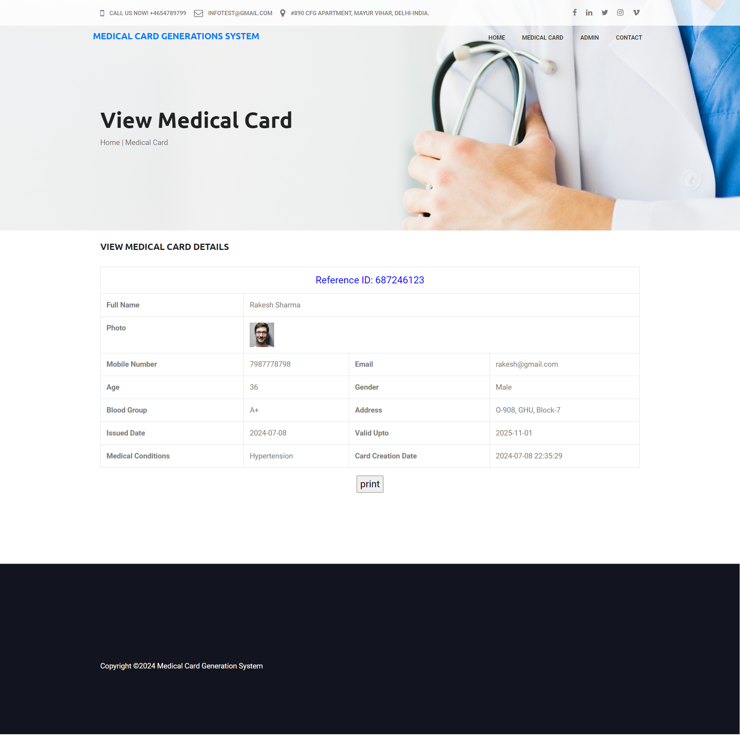

Slide 24
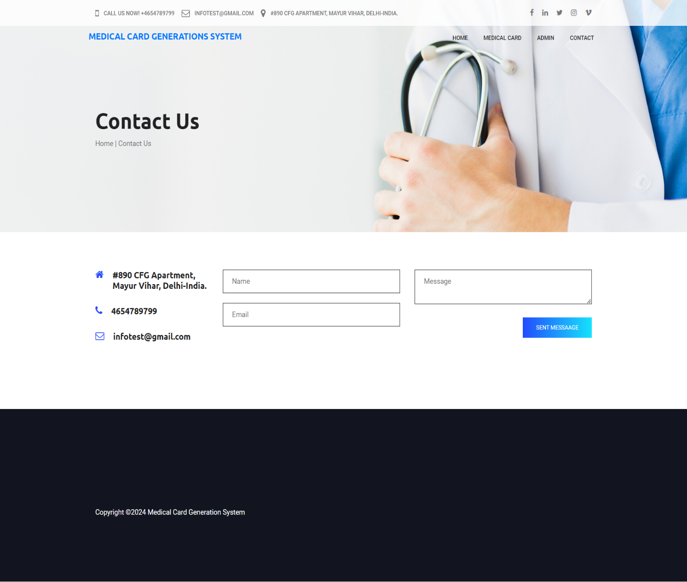

Slide 25
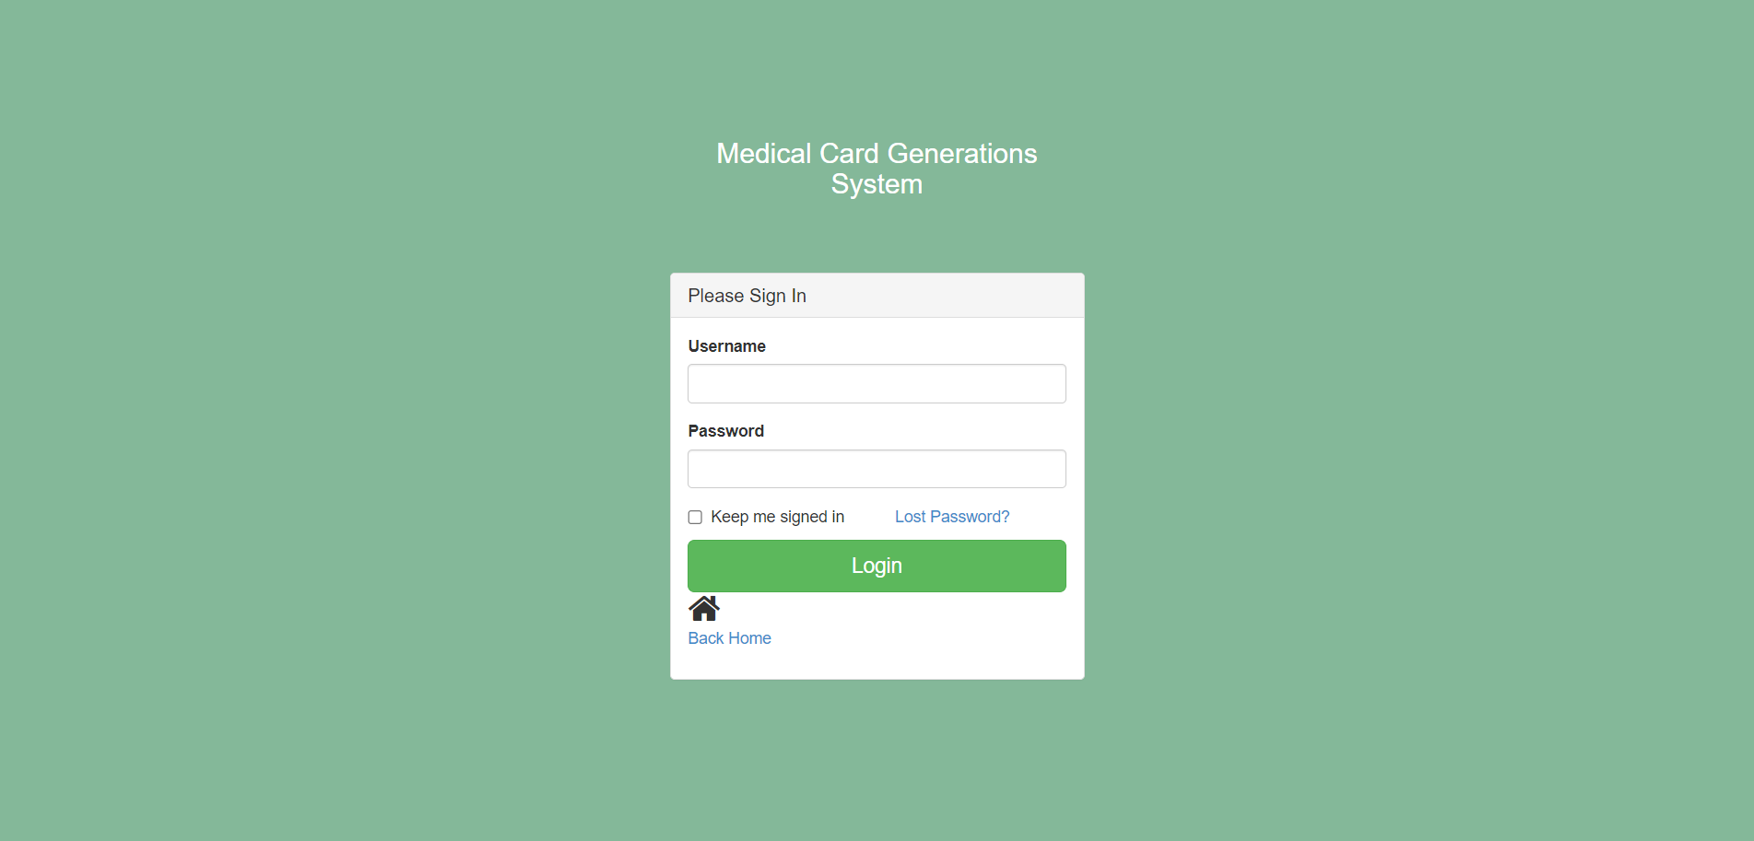
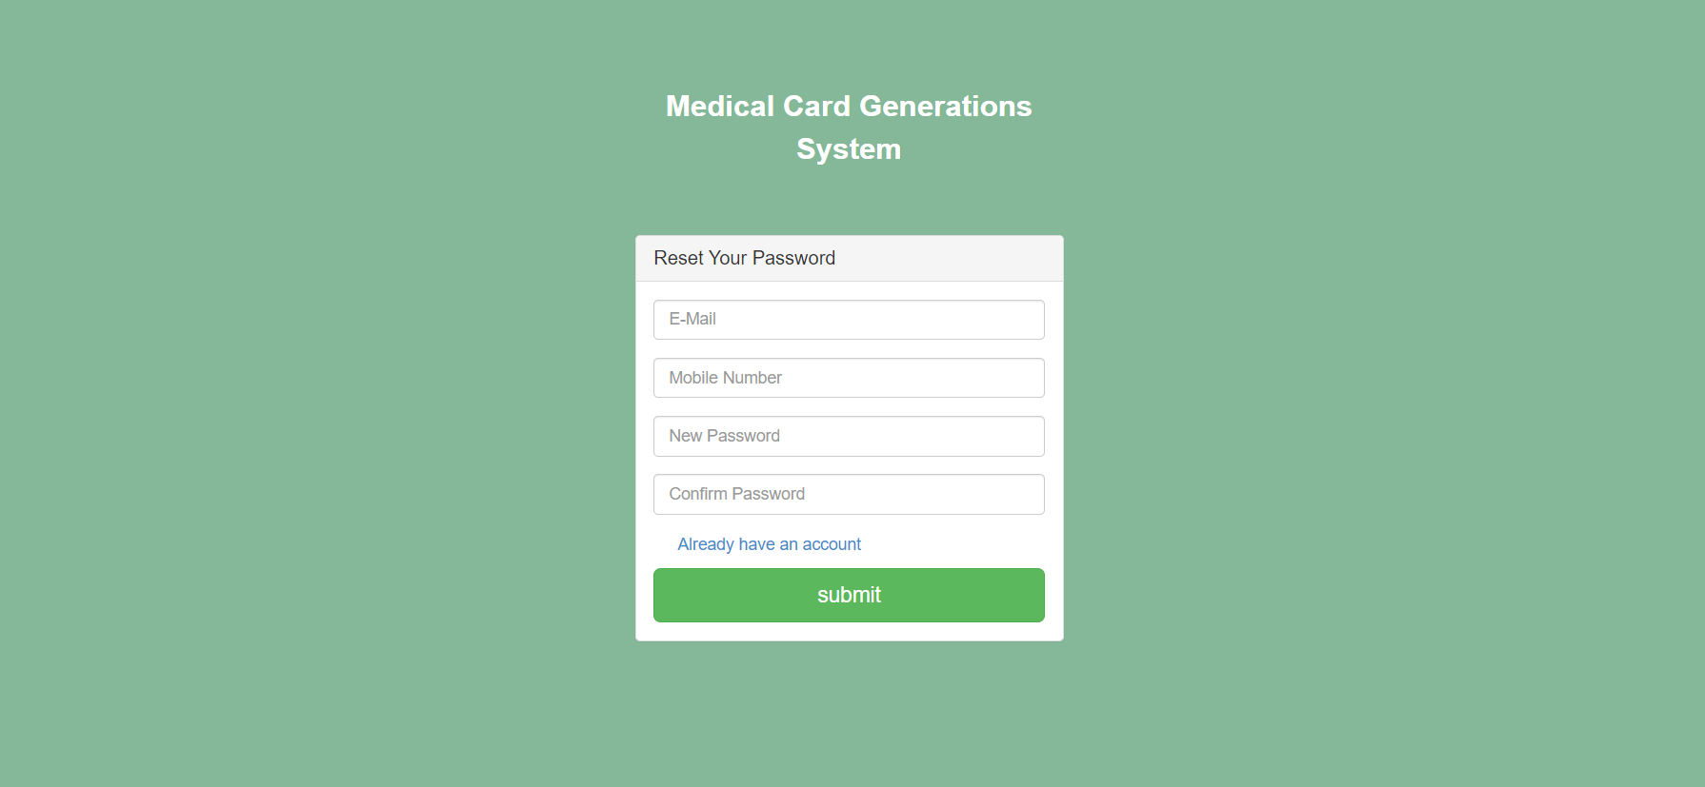

Slide 26
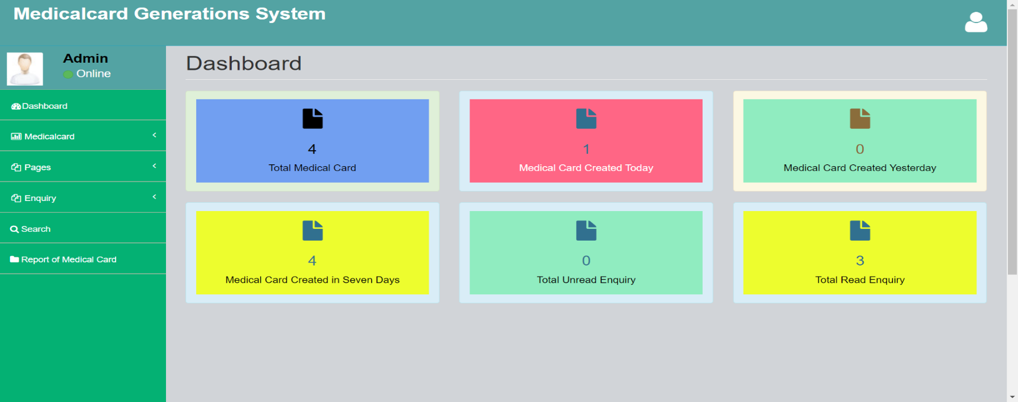
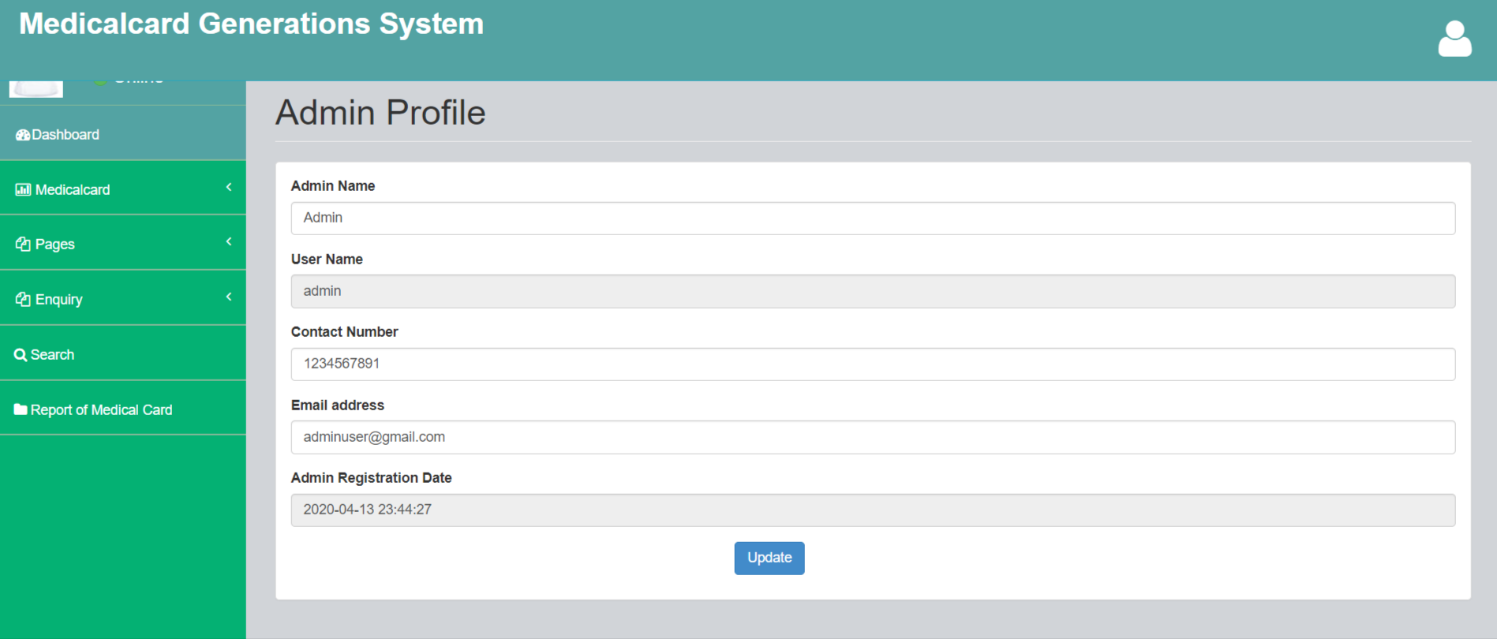

Slide 27
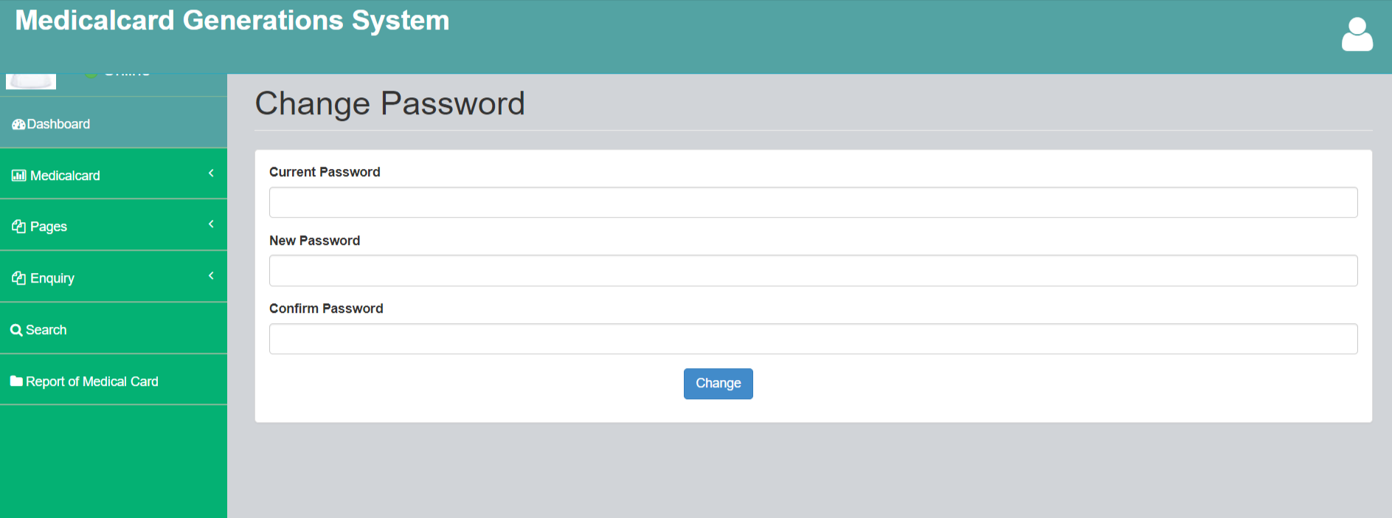
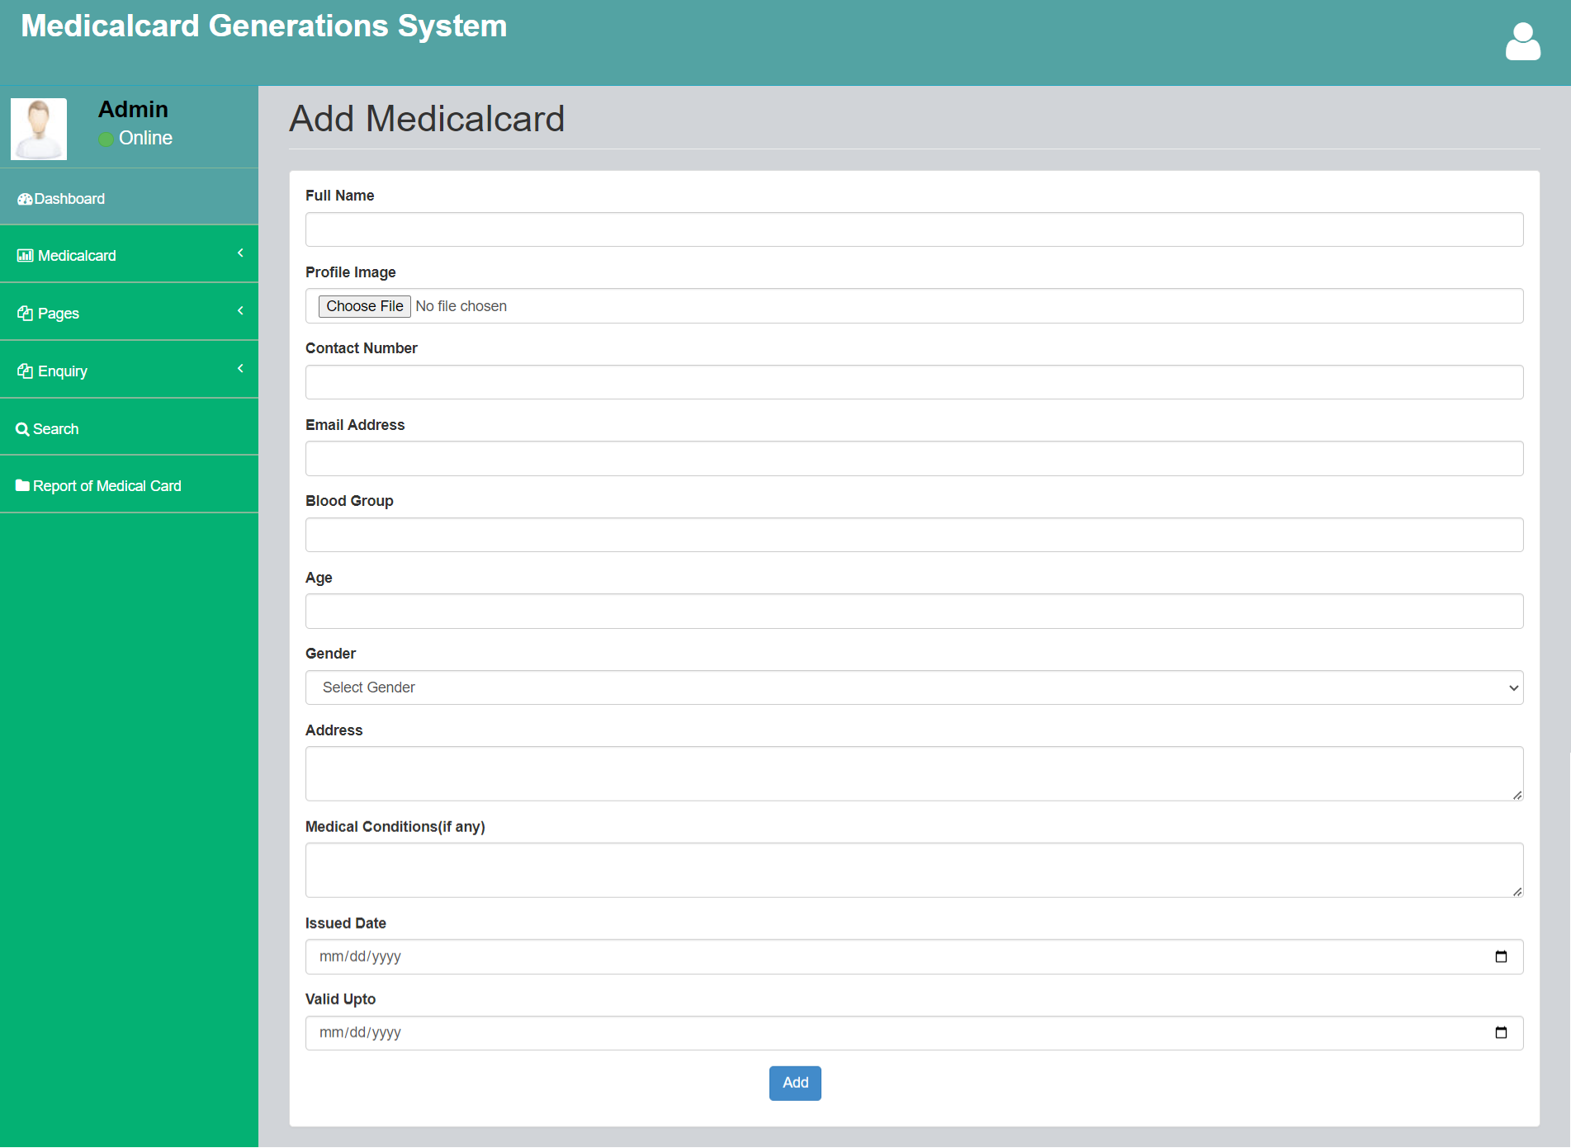

Slide 28
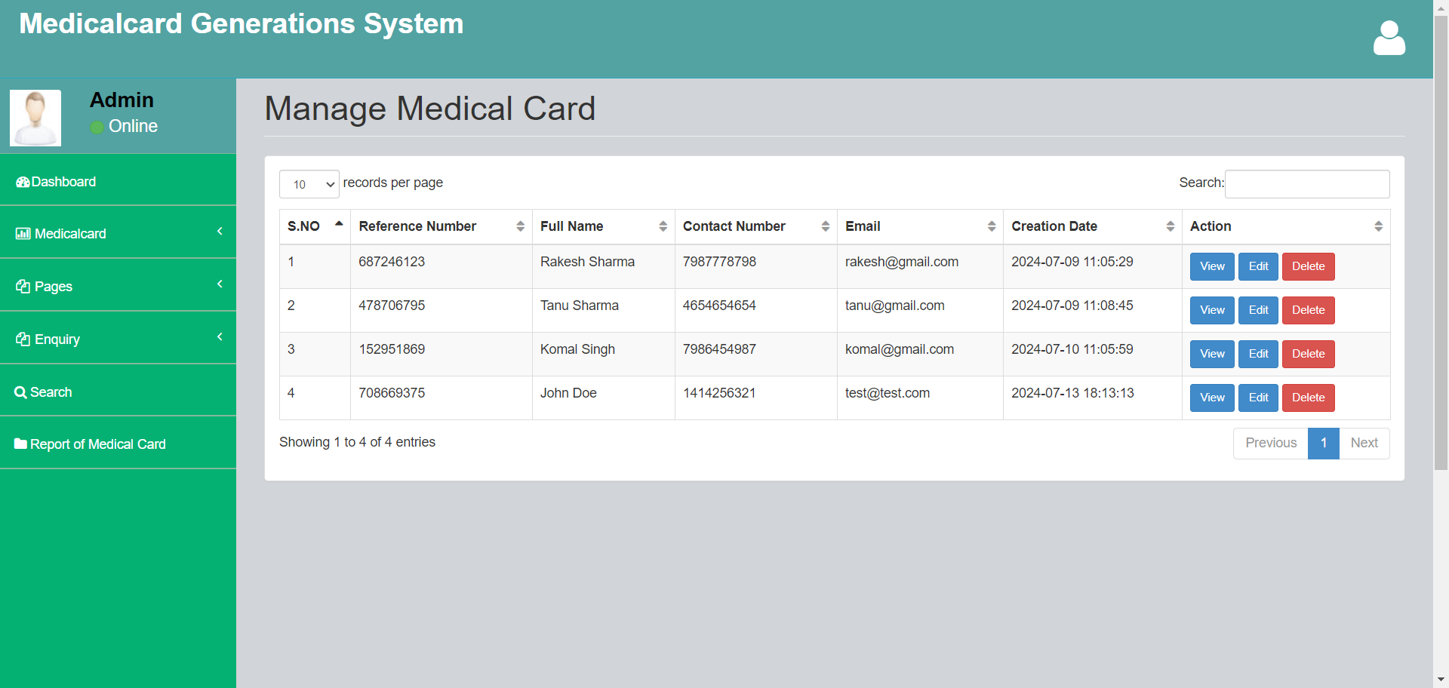
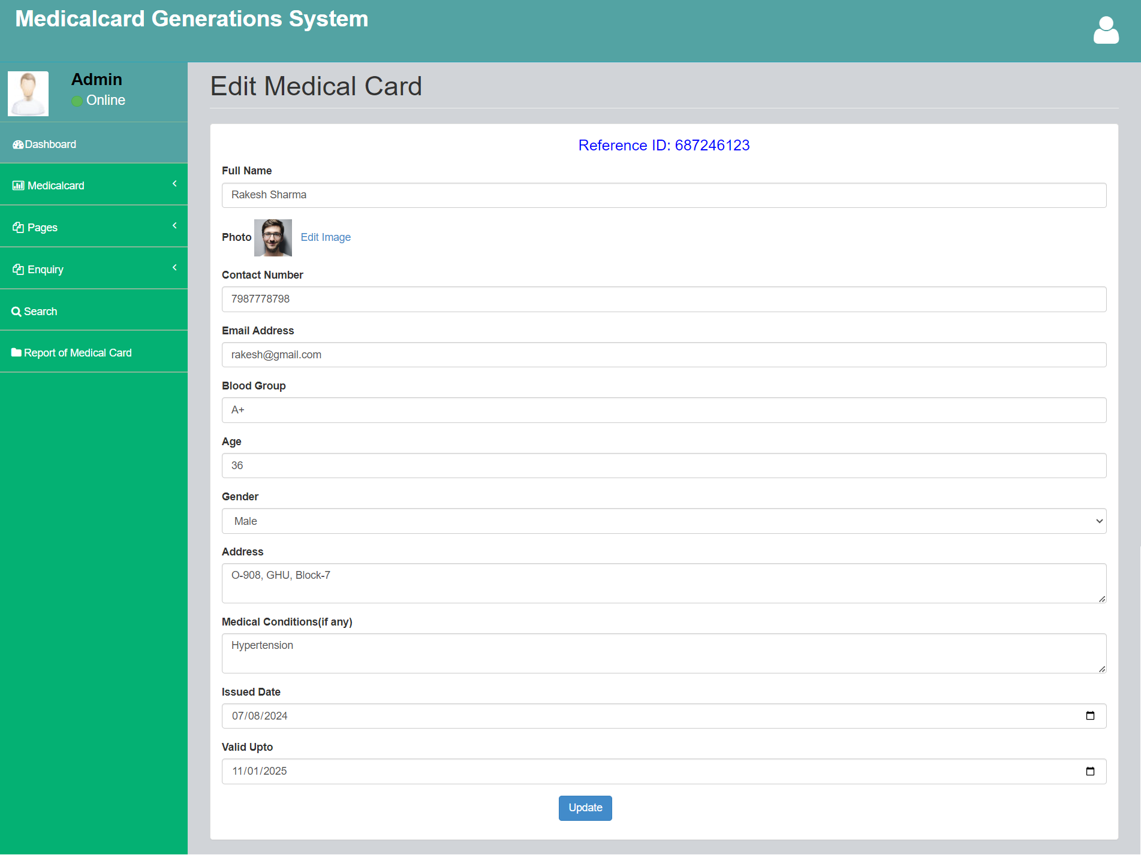

Slide 29
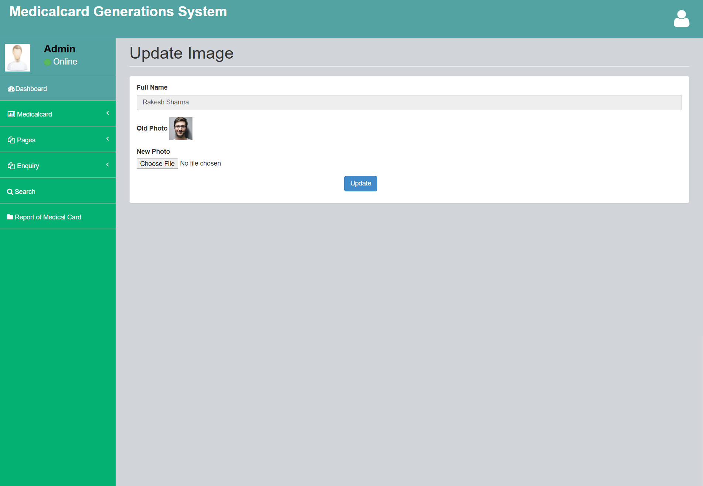
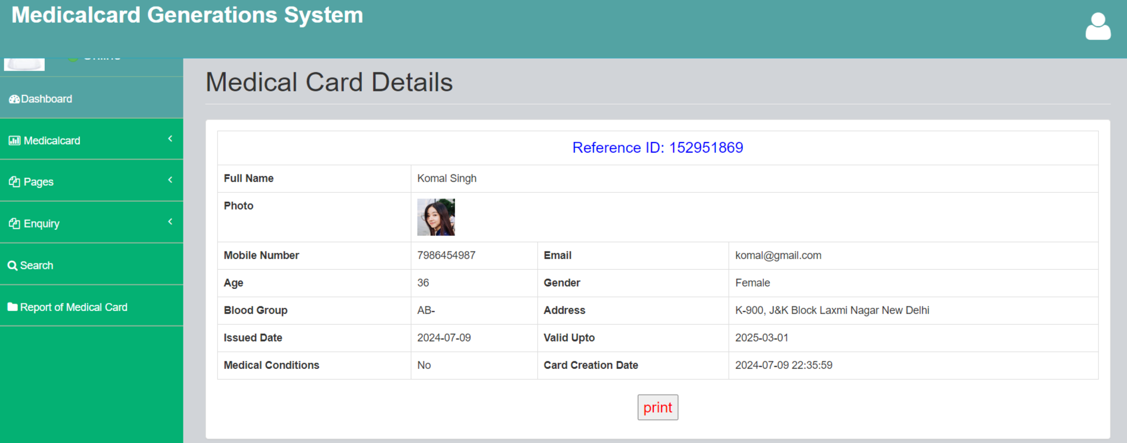

Slide 30
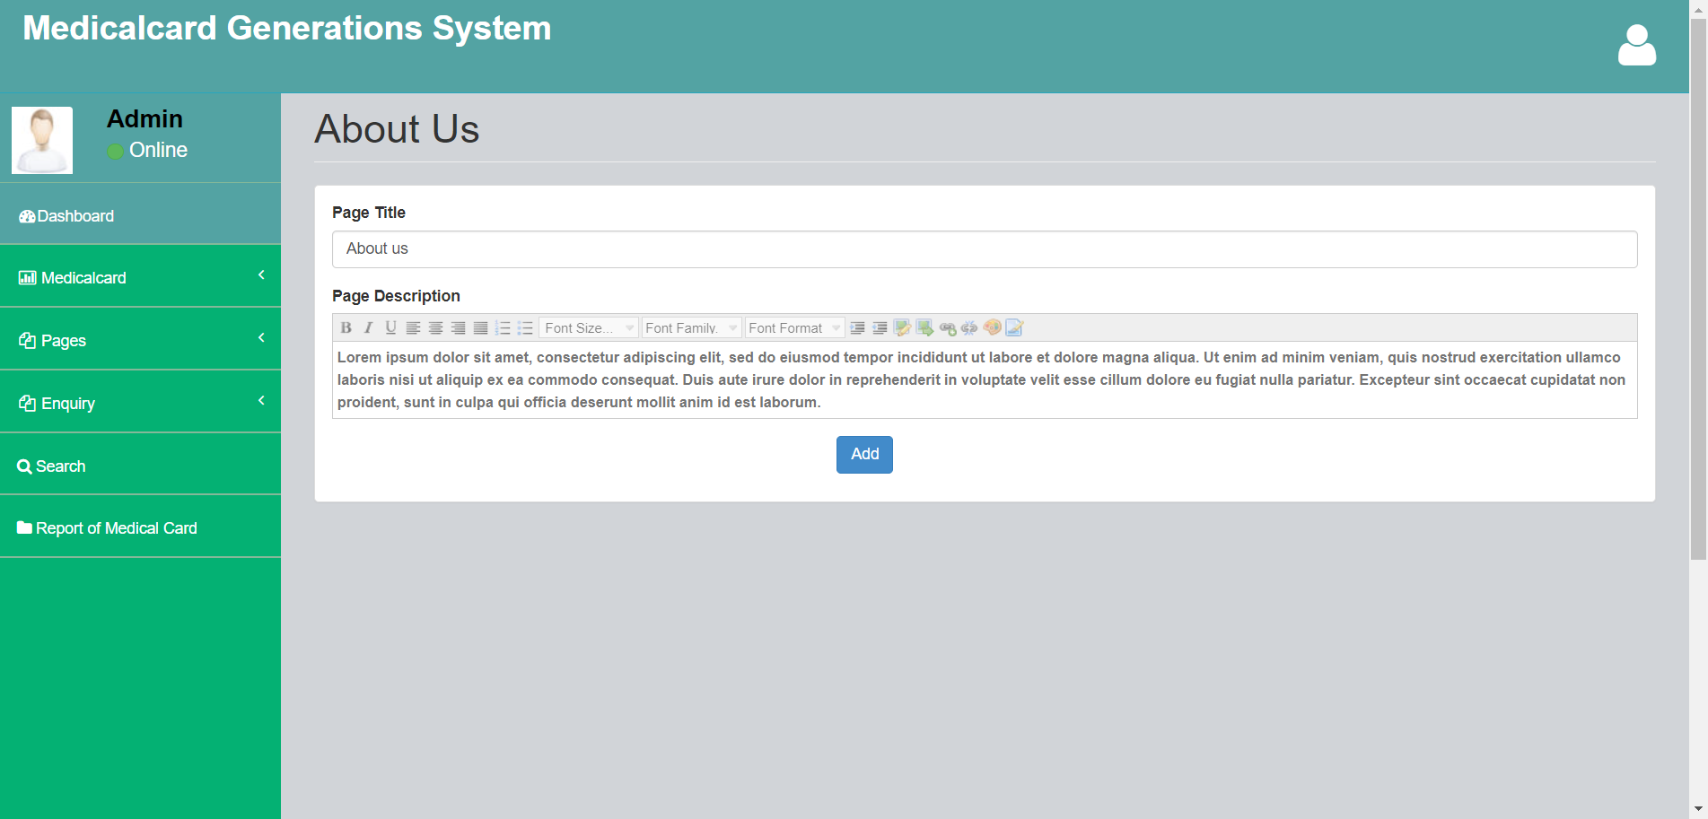
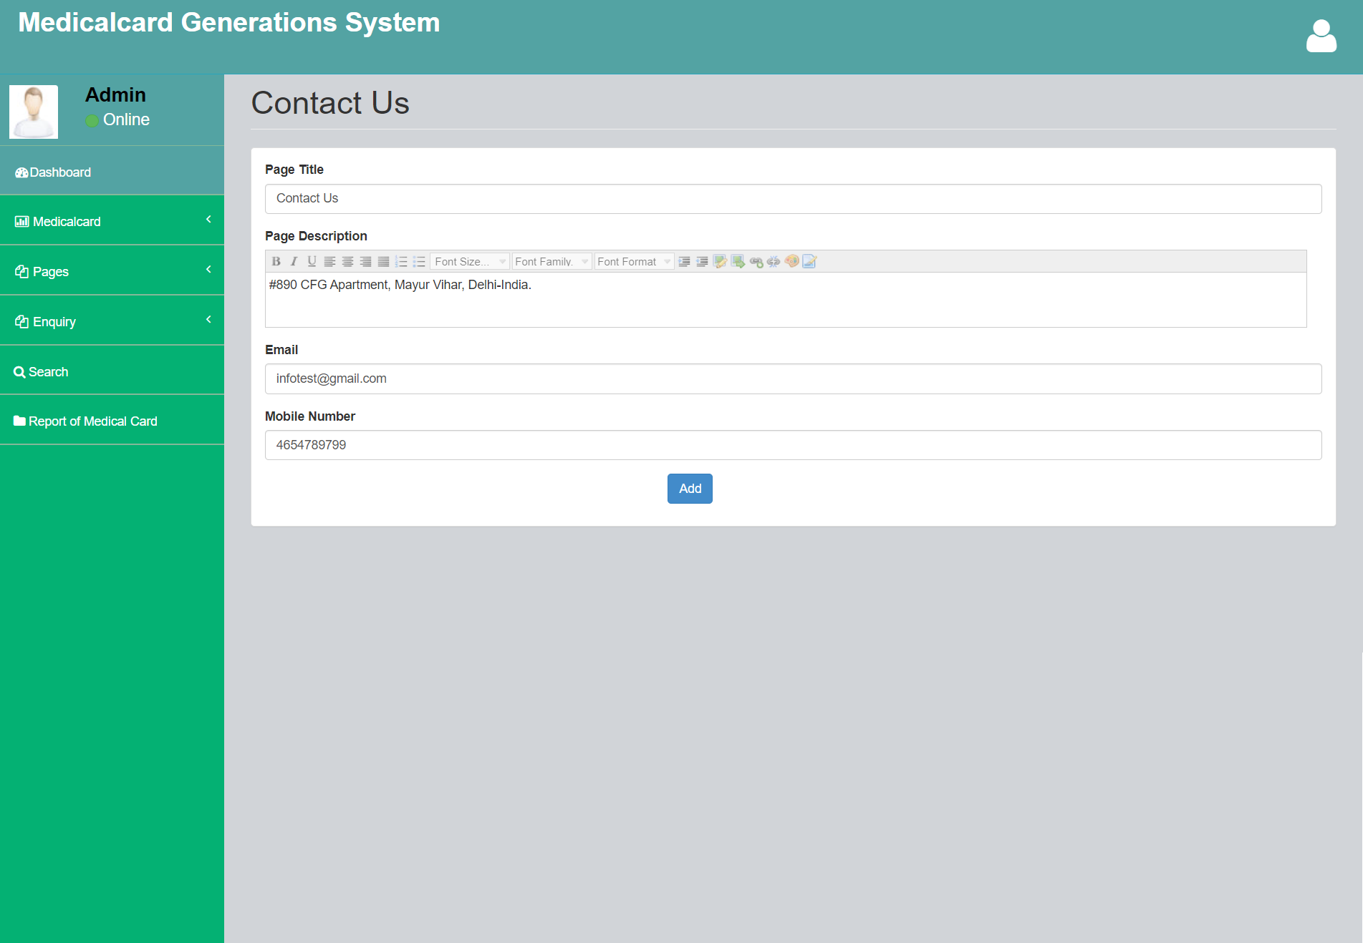

Slide 31
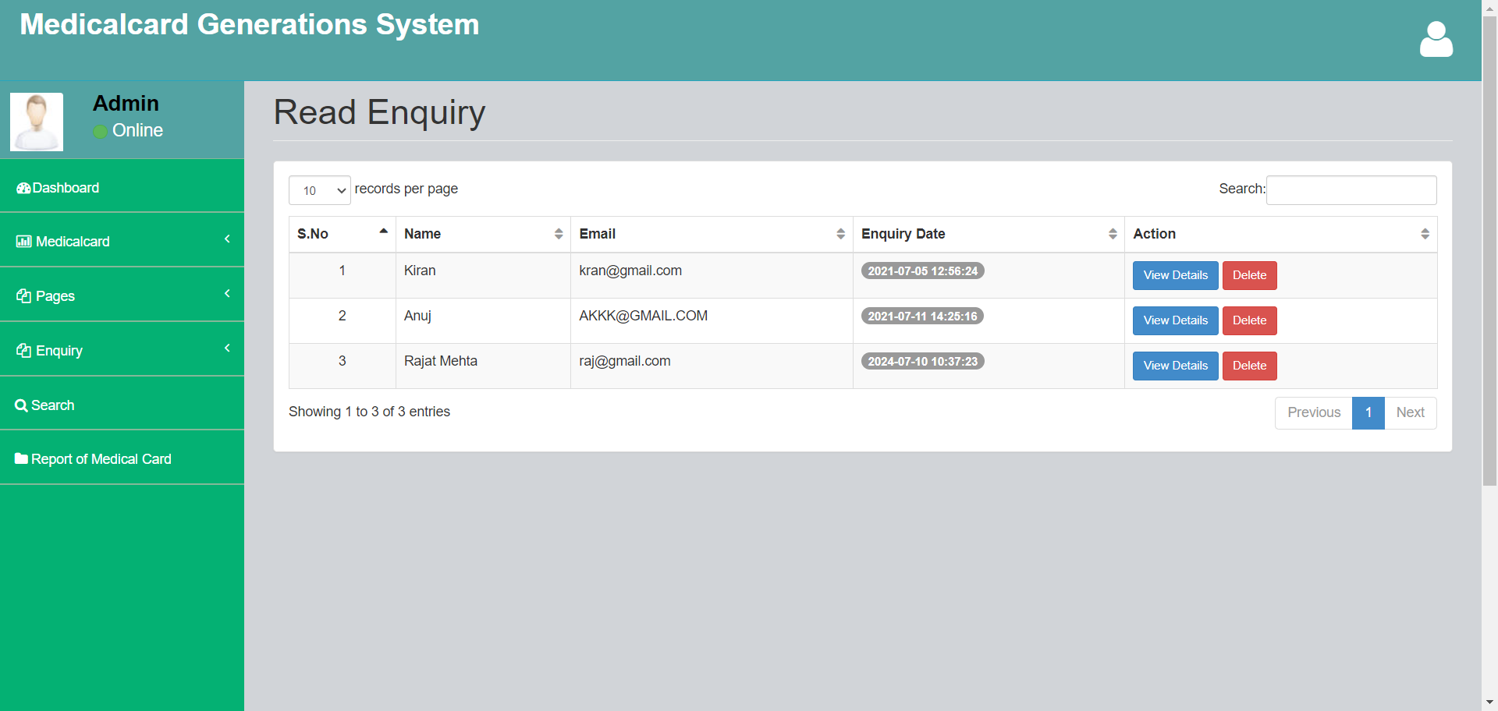
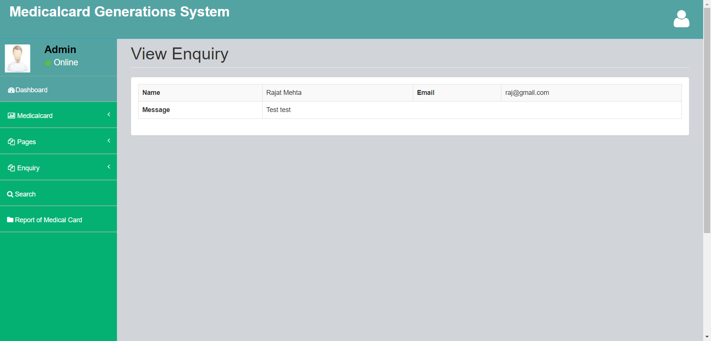

Slide 32
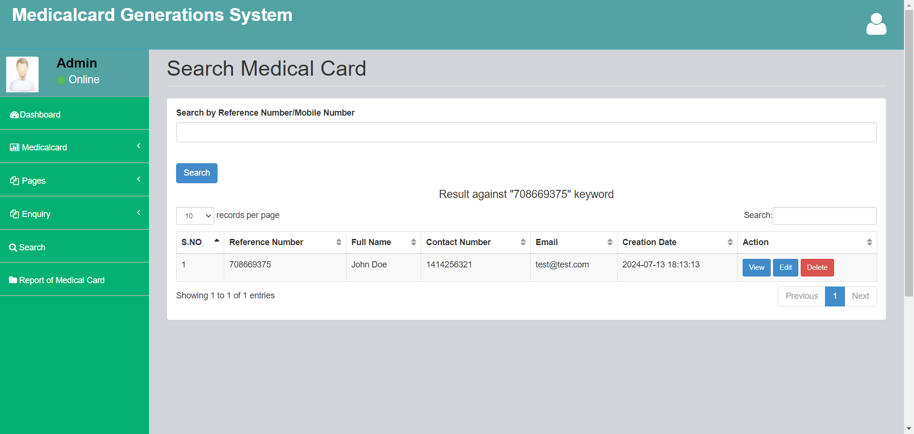
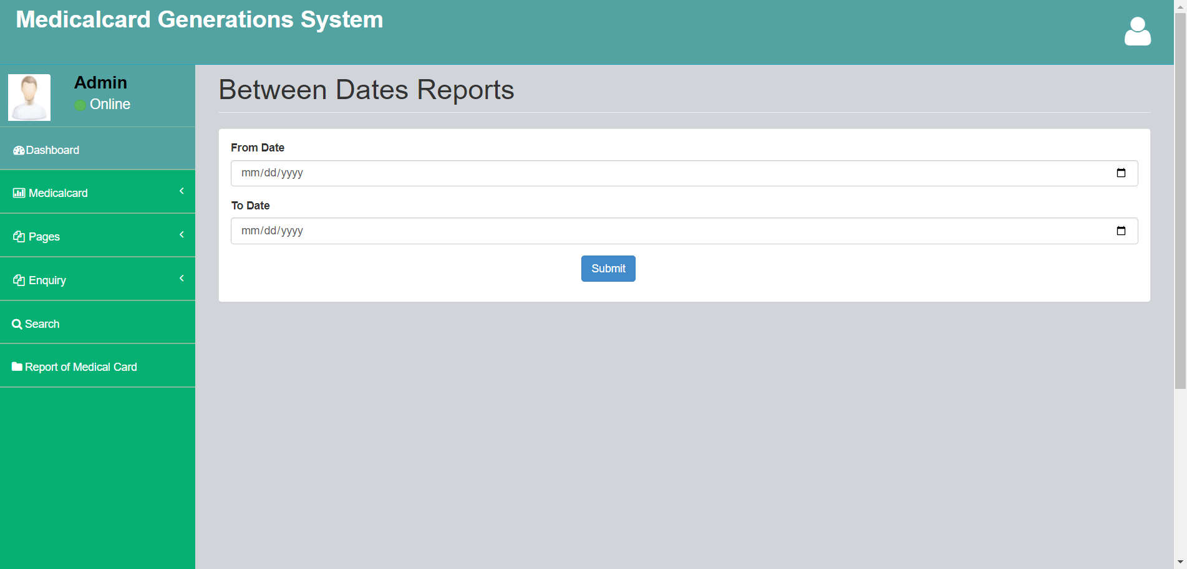

Slide 33
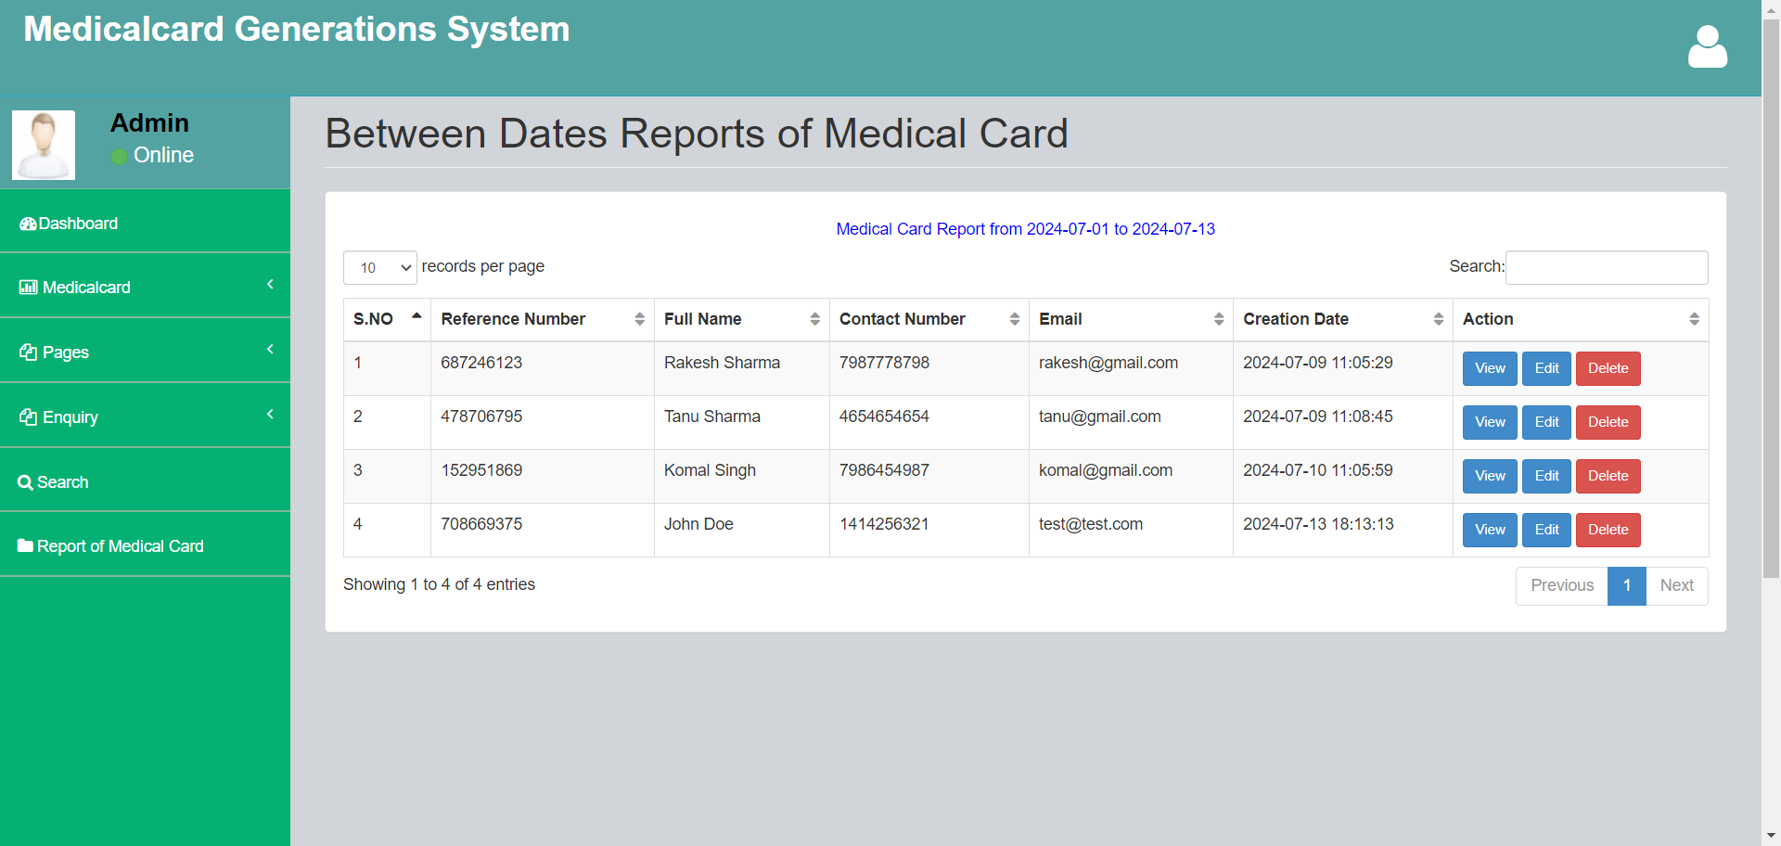

Slide 34
Conclusion
This Application provides a computerized and automated version of “Medical Card Generations System” which will benefit the users.
The Application was designed in such a way that future changes can be done easily. The following conclusions can be deduced from the development of the project.
Automation of the entire system improves the productivity.
It provides a friendly graphical user interface which proves to be better when compared to the existing system.
It gives appropriate access to the authorized users depending on their permissions.
It effectively overcomes the delay in communications.
Updating of information becomes so easier.
System security, data security and reliability are the striking features.
The System has adequate scope for modification in future if it is necessary.

Slide 35
References
For PHP
https://www.w3schools.com/php/default.asp
https://www.sitepoint.com/php/
https://www.php.net/
For MySQL
https://www.mysql.com/
http://www.mysqltutorial.org
For XAMPP
https://www.apachefriends.org/download.html

Slide 36
Thank You

